Slide 1
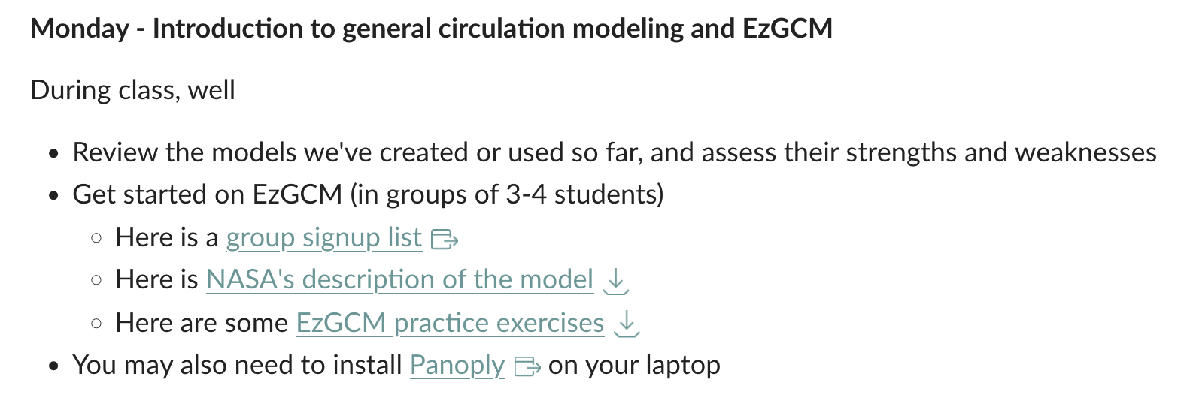
Today

Slide 2
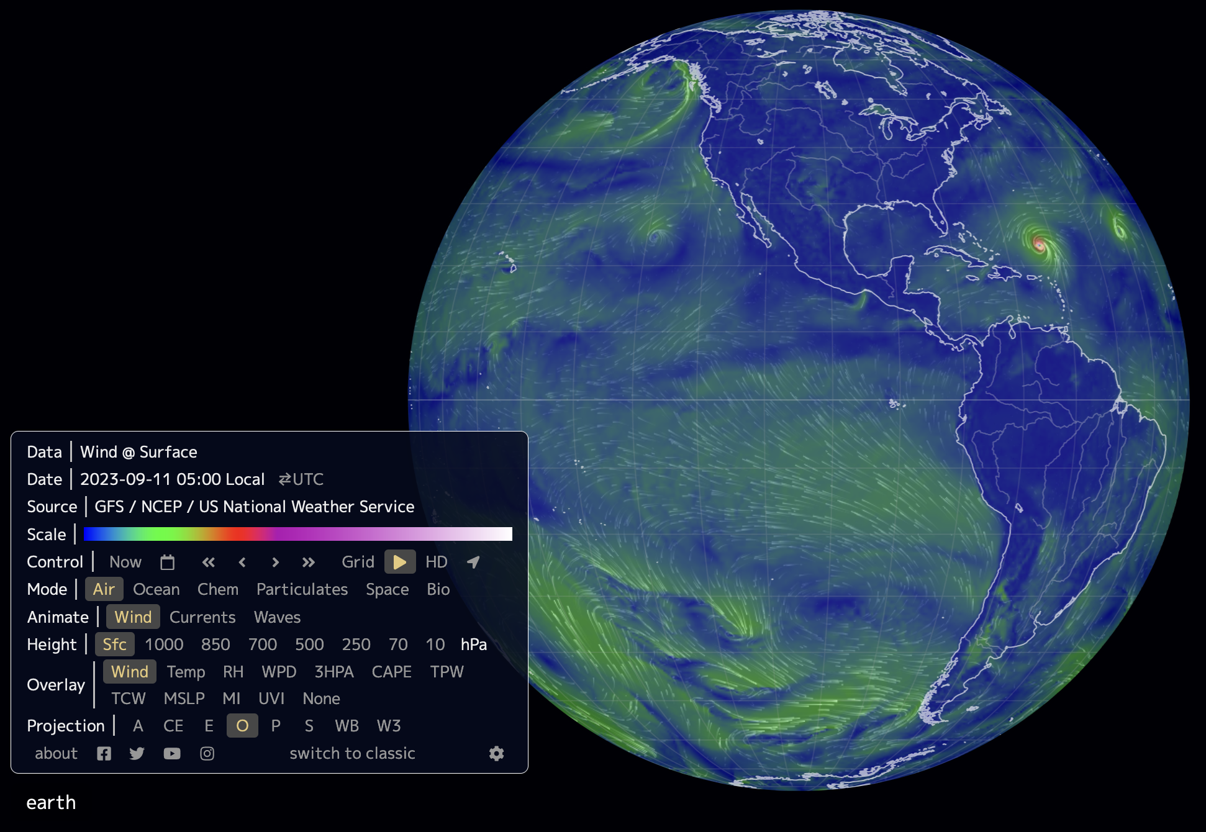
Earth.nullschool.net: cyclonic & anticyclonic synoptic systems, MI, MSLP, PM2.5, etc.

Slide 3
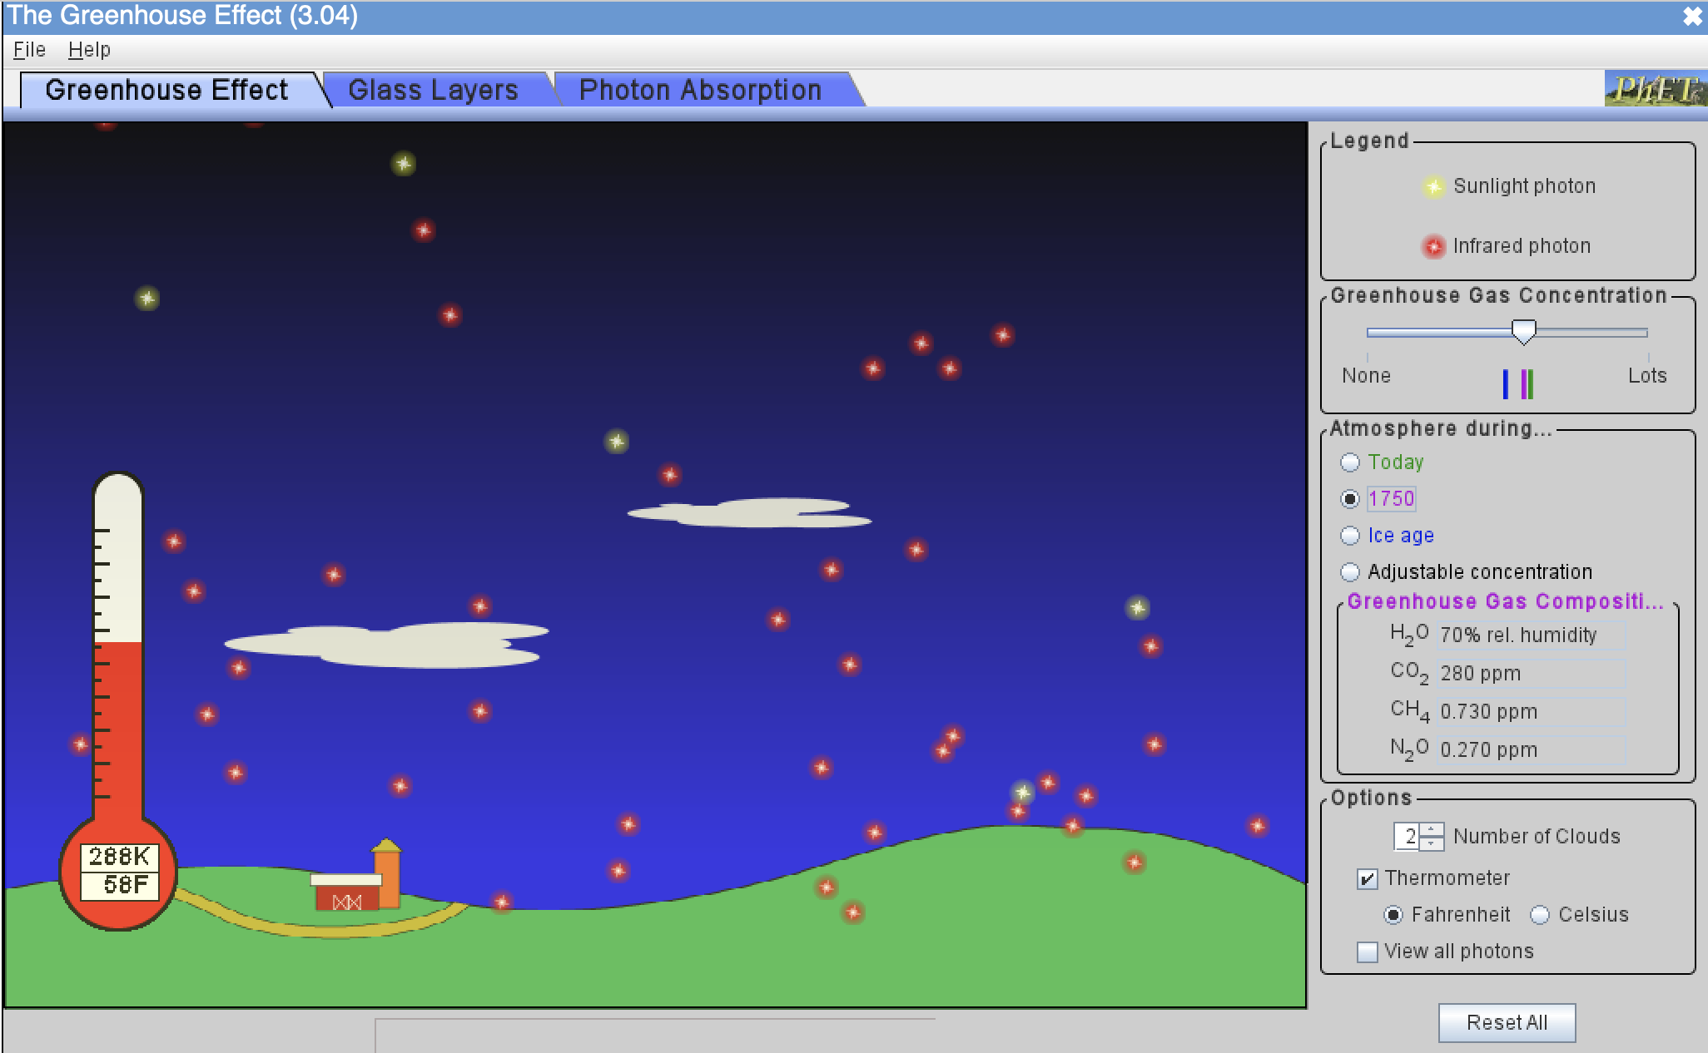
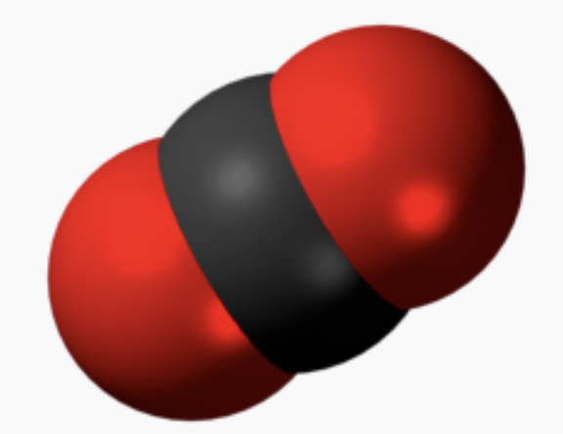
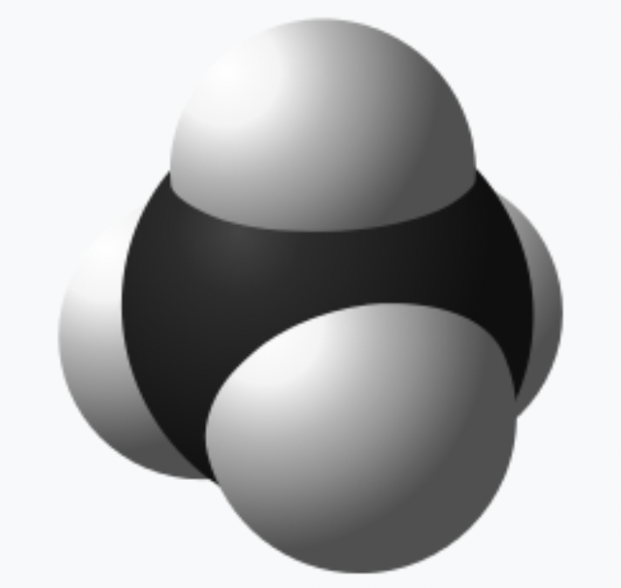
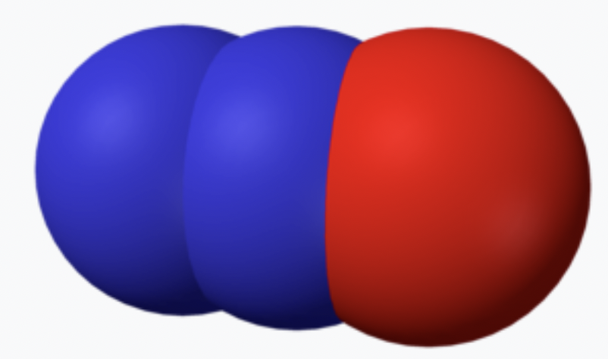
The phet greenhouse effect simulator: Greenhouse gases
Greenhouse gases and their typical concentrations:
CO₂ (was 280 ppm, now 423)
CH₄ (was 0.73 ppm, now almost 2)
N₂O (was 0.27 ppm, now 0.34)

Slide 4
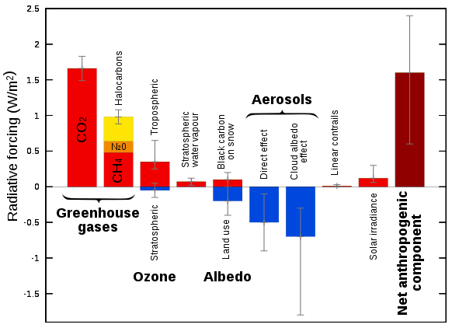
Here are the biggest radiative forcings we think are operating
Forcings of GHGs are all positive, of course. CO₂ is a very long-lived forcing (it stays in the atmosphere for 100s of years).
The forcing due to albedo reduction we talked about before is also on the order of 1-2 W/m²)
There are negative forcings too, which have been protecting the planet from overheating. Unfortunately, those are all short-lived (a few years) hence Hansen’s Faustian Bargain.
Either way, the long-term effects of these forcings should be multiplied by feedback factors that we will have to deal with eventually.

Slide 5
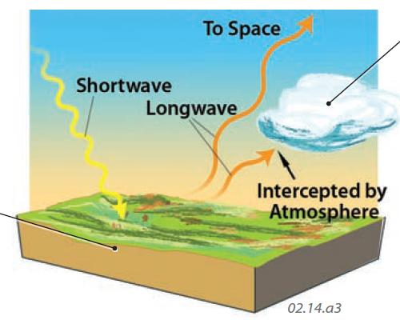
Simple Radiative Balance recap: ASR and OLR
ASR
OLR

Slide 6
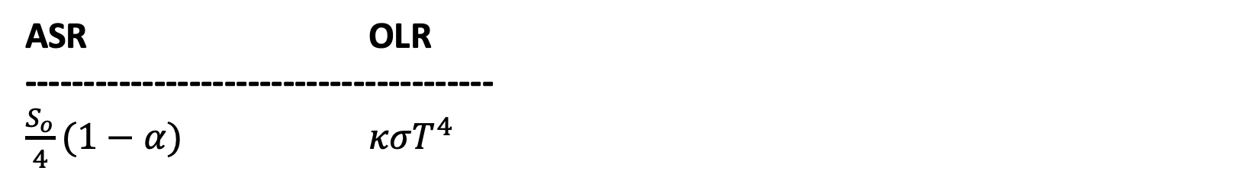
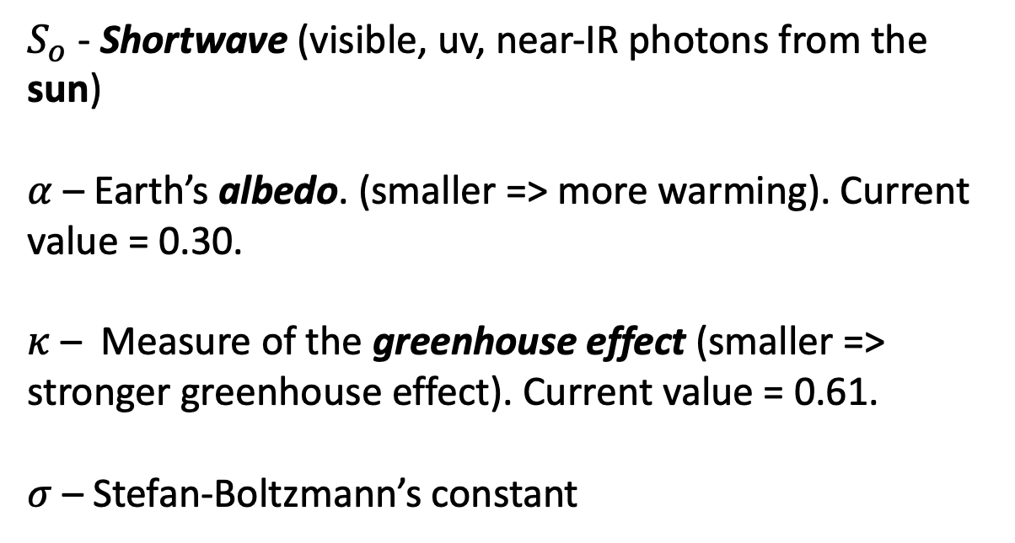
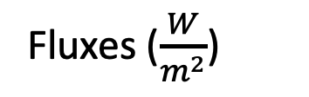
Simple Radiative Balance recap: shortwave, longwave, $α$, $S_{o}$, 𝜅, 𝜎
ASR OLR
----------------------------------------
$\frac{S_{o}}{4}(1−α)$ $κσT^{4}$
$S_{o}$ - Shortwave (visible, uv, near-IR photons from the sun)
$α$ – Earth’s albedo. (smaller => more warming). Current value = 0.30.
$κ$ – Measure of the greenhouse effect (smaller => stronger greenhouse effect). Current value = 0.61.
$σ$ – Stefan-Boltzmann’s constant
Fluxes ($\frac{W}{m^{2}}$)

Slide 7
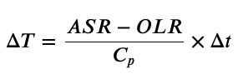
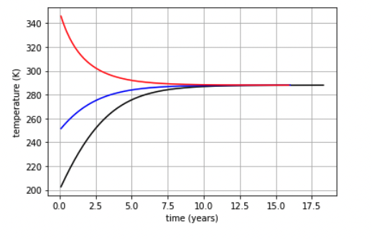
Simple Radiative Balance recap: Homeostasis
Homeostasis
When ASR = OLR
Leads to the idea of a “Goldilocks Temperature”
Doesn’t depend the earth’s starting temperature.

Slide 8
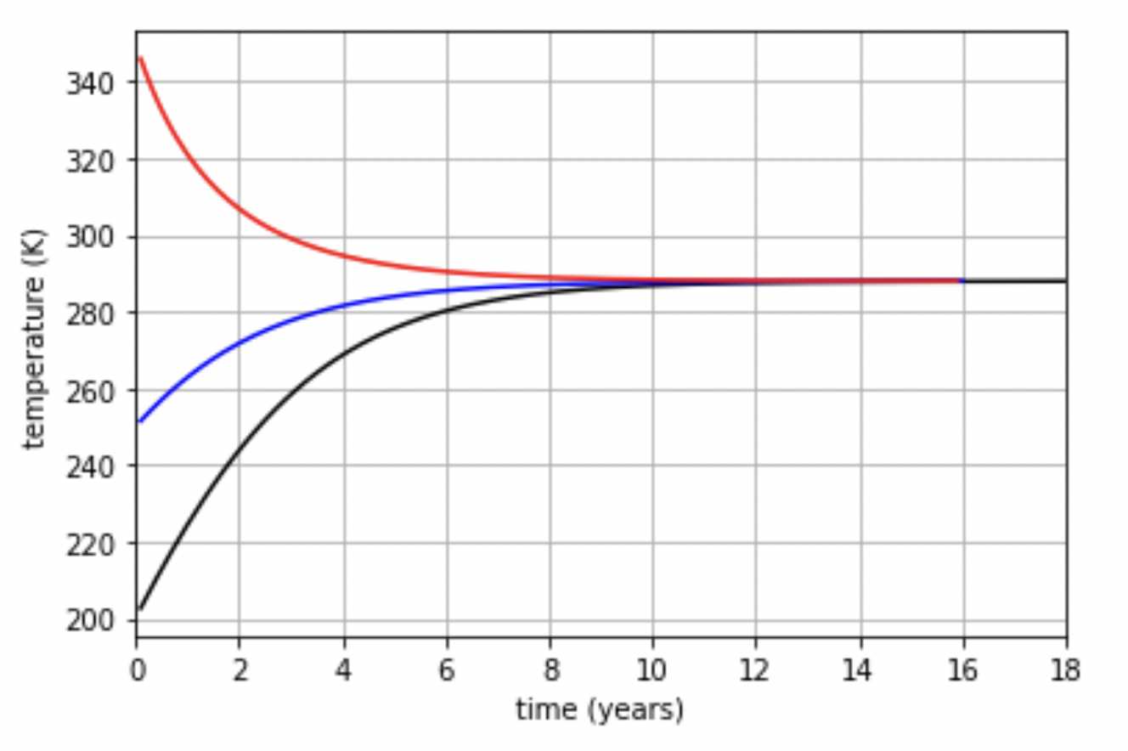
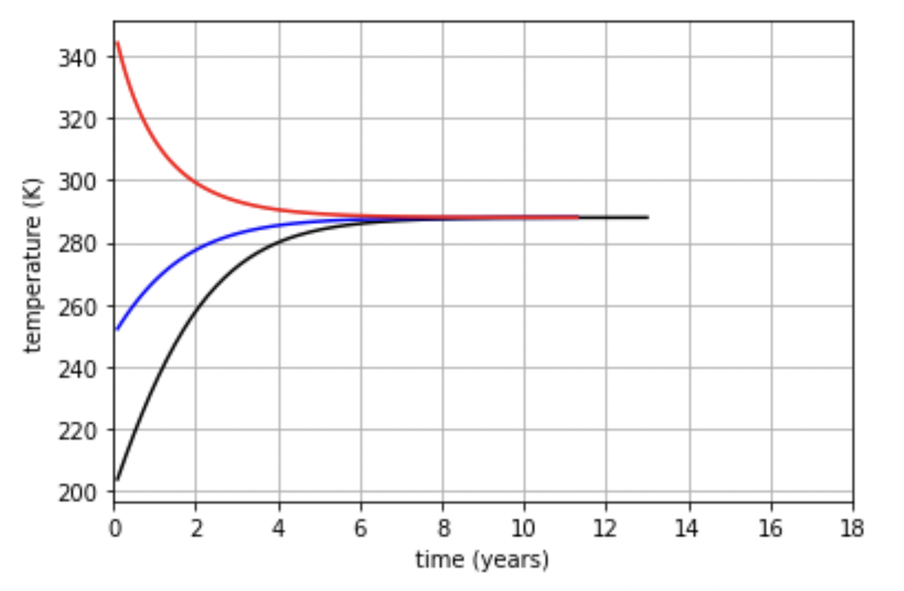
Simple Radiative Balance recap: Heat capacity
Heat capacity we used in our simulations (average of ocean+land)
With a smaller heat capacity (land)

Slide 9
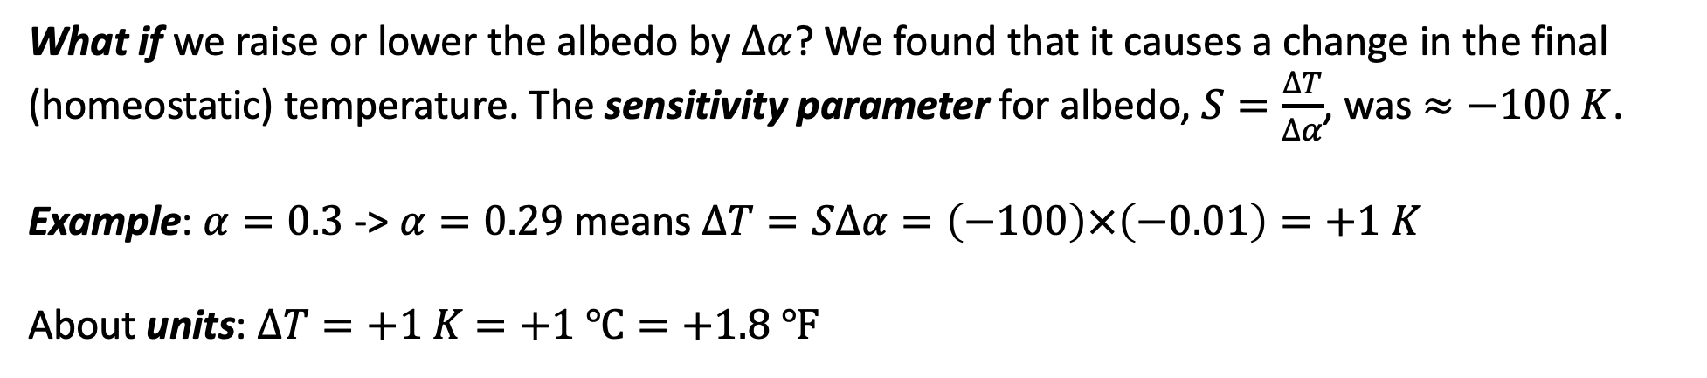
Simple Radiative Balance recap: What-if experiments and Sensitivity Parameters
What-if?
What if we raise or lower the albedo by $∆α$? We found that it causes a change in the final (homeostatic) temperature. The sensitivity parameter for albedo, $S=\frac{∆T}{∆α}$, was $≈−100 K$.
Example: $α=0.3$ -> $α=0.29$ means $∆T=S∆α=\left(−100\right)×\left(−0.01\right)=+1 K$
About units: $∆T=+1 K$ $=+1 ℃=+1.8 ℉$

Slide 10
What do we want in a model?
 | Geographical precision? | What-if scenarios? | Adequate set of physical processes?
Earth.nullschool | Yes |  | Seems like a lot
phet |  | Clouds, GHG concentrations
SRB |  | Albedo

Slide 11
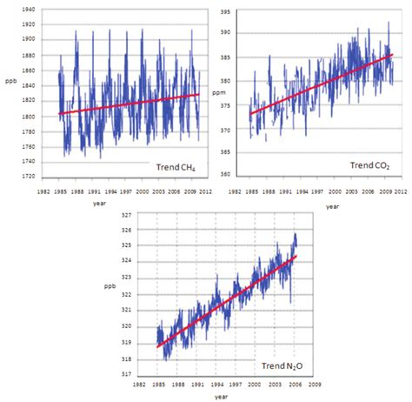
What do we want in a model?
 | Geographical precision? | What-if scenarios? | Adequate set of physical processes?
Earth.nullschool | Yes |  | Seems like a lot
phet |  | Clouds, GHG concentrations
SRB |  | Albedo

Slide 12
What do we want in a model?
 | Geographical precision? | What-if scenarios? | Adequate set of physical processes?
Earth.nullschool | Yes |  | Seems like a lot
phet |  | Clouds, GHG concentrations
SRB |  | Albedo
GCM | Yes | Clouds, GHG concentrations and emissions | Depends on the model

Slide 13
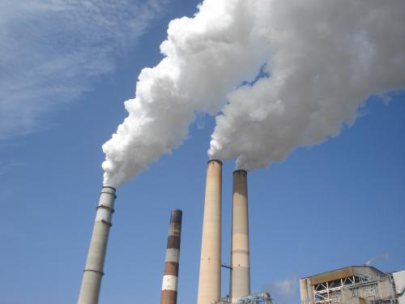
What do we want in a model?
 | Geographical precision? | What-if scenarios? | Adequate set of physical processes?
Earth.nullschool | Yes |  | Seems like a lot
phet |  | Clouds, GHG concentrations
SRB |  | Albedo
GCM | Yes | Clouds, GHG concentrations and emissions | Depends on the model

Slide 14
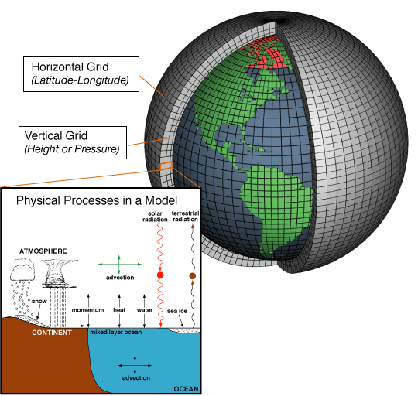
GCMs separate the world into grid cells

Slide 15
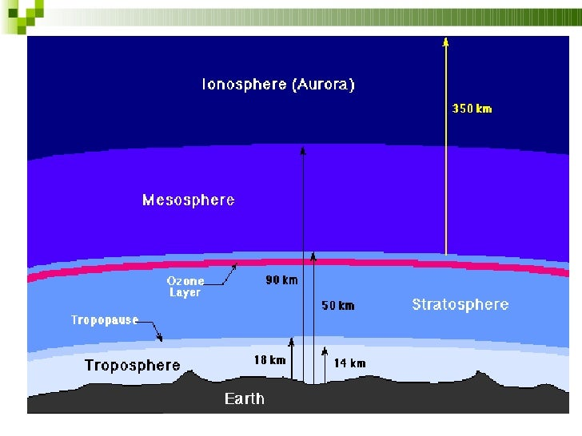
Vertically, the most important grid points the troposphere & stratosphere
Together, the Troposphere and Stratosphere contain most of the air!
However, their thickness spans less than 1% of Earth’s radius (~6000 km) – like the skin of an apple.
For comparison, Seattle is all of 50 km from Tacoma (horizontally).
Earth’s surface

Slide 16
Vertically, the most important grid points the troposphere & stratosphere
Together, the Troposphere and Stratosphere contain most of the air!
However, their thickness spans less than 1% of Earth’s radius (~6000 km) – like the skin of an apple.
For comparison, Seattle is all of 50 km from Tacoma (horizontally).
Earth’s surface

Slide 17
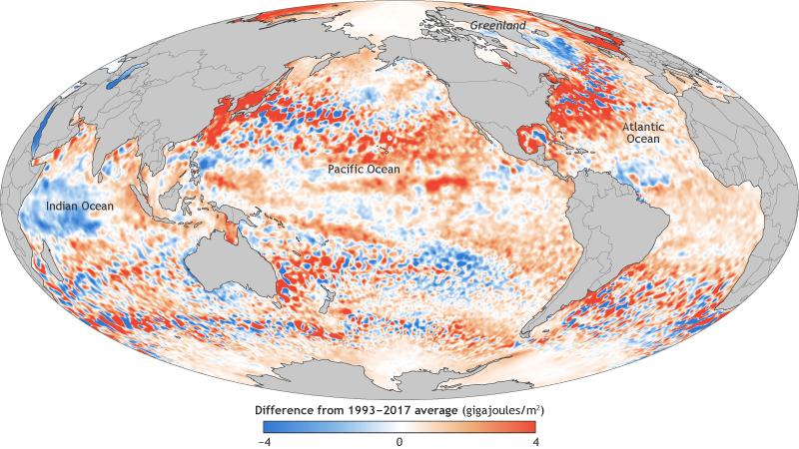
Horizontally, we need grid cells small enough to distinguish coast lines, mountains, etc.

Slide 18
EzGCM
Monday - Introduction to general circulation modeling and EzGCM
During class, well
Review the models we've created or used so far, and assess their strengths and weaknesses
Get started on EzGCM (in groups of 3-4 students)
Here is a group signup list.
Here is NASA's description of the model
Here are some EzGCM practice exercises
For more control over displays, you'll need to install Panoply on your laptop
Key Questions over the coming weeks:
What are key differences between scenarios?
RCPs 2.6-8.5 (polar vs mid-latitudes)
Doubled CO₂
Ice ages?
What limitations does global climate modeling hold as a research tool for understanding and predicting anthropogenic global climate change?

